Slide 1

Data Management for Analytics
Prajwal Gowda

Slide 2

USE CASE STUDY REPORT

Slide 3
PML is a metal company planning to open a new manufacturing plant in India. The company needs a database system to store all its master and transaction data.
Two business flow of any ERP software are:
1) Procure to pay:
2) Quote to Cash:

Slide 4
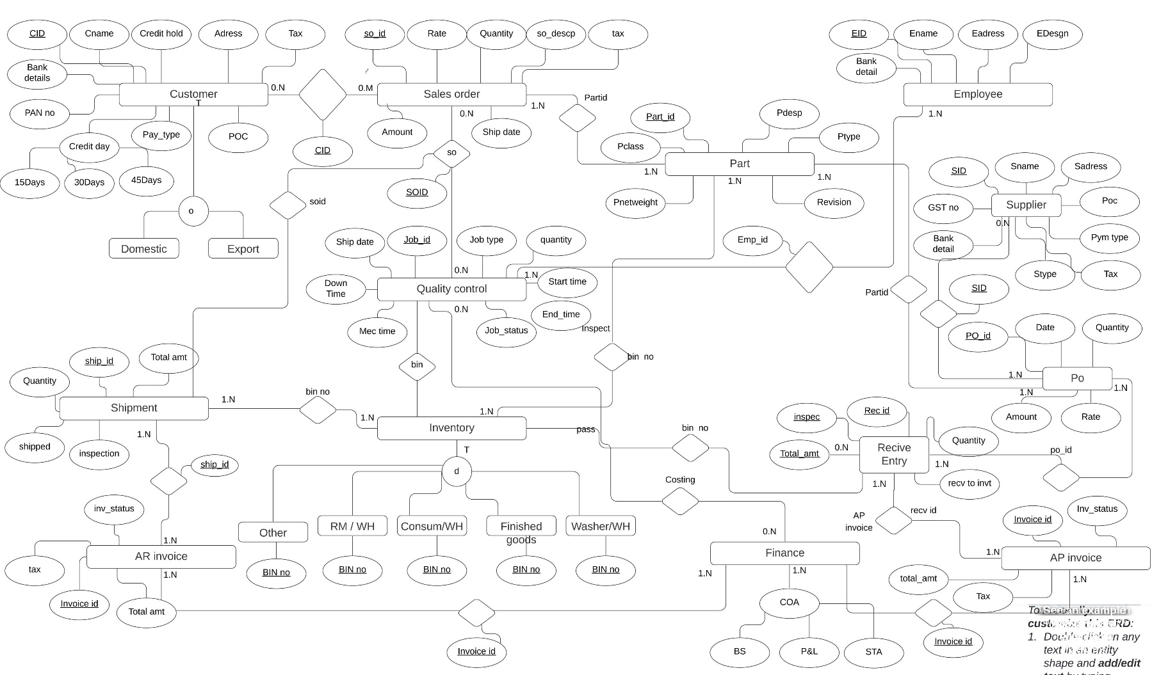
EER Diagram

Slide 5
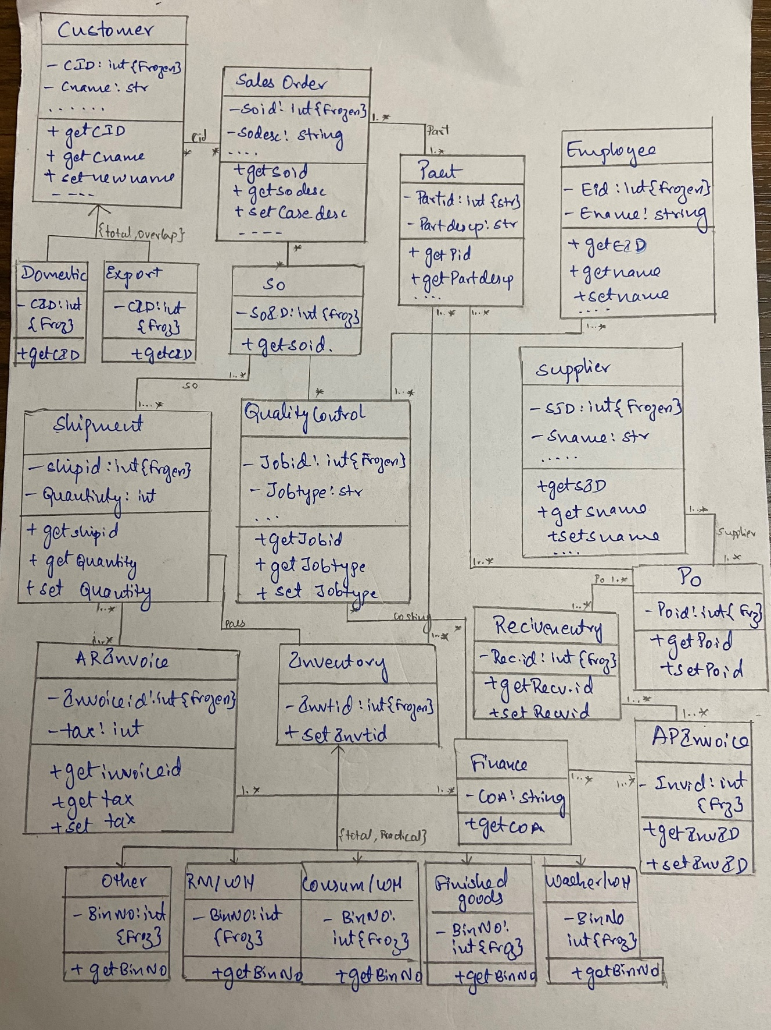
UML Diagram

Slide 6

MYSQL Implementation
1. Find sales order id, customer id, part id, ship id, invoice id and total amount with sales description whose letter or number start with “1%”.
2. Find PO ID, Part ID and Quantity using purchase order and describe the duration of quantity that should be completed in one to five days using case when
3. Find supplier id, supplier name, payment type and tax whose purchase order rate is less than equal to 500

Slide 7
NOSQL Implementation
Find customer those tax is 28 and ship id is 4
Find customers with total amount more than 50000
Using Aggregate function find the invoice and total amount which is sorted by total amount = 1.

Slide 8
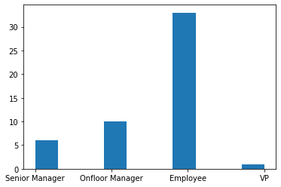
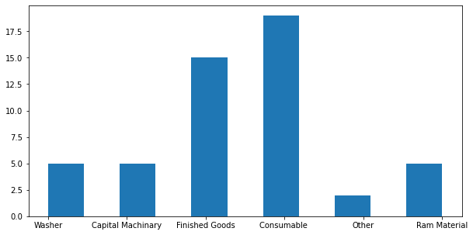
Database access Via Python
Graph1: Employees and their Designation
Graph2: Different and number of warehouses in the company

Slide 9
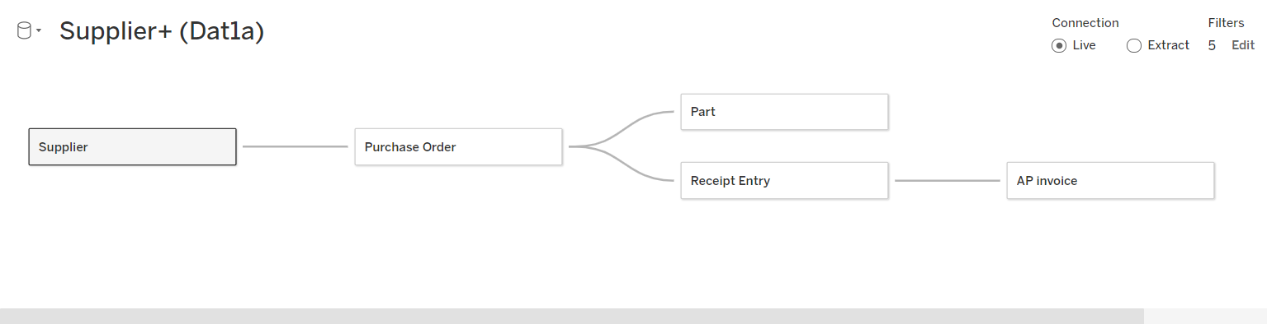
Tableau
Connected procure to pay that is Supplier to AP invoice.

Slide 10
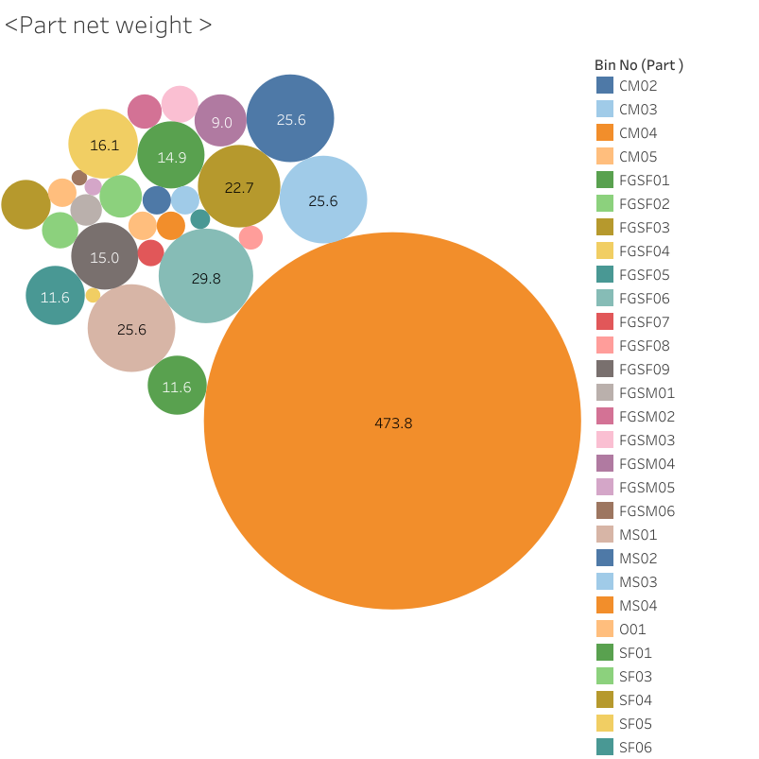
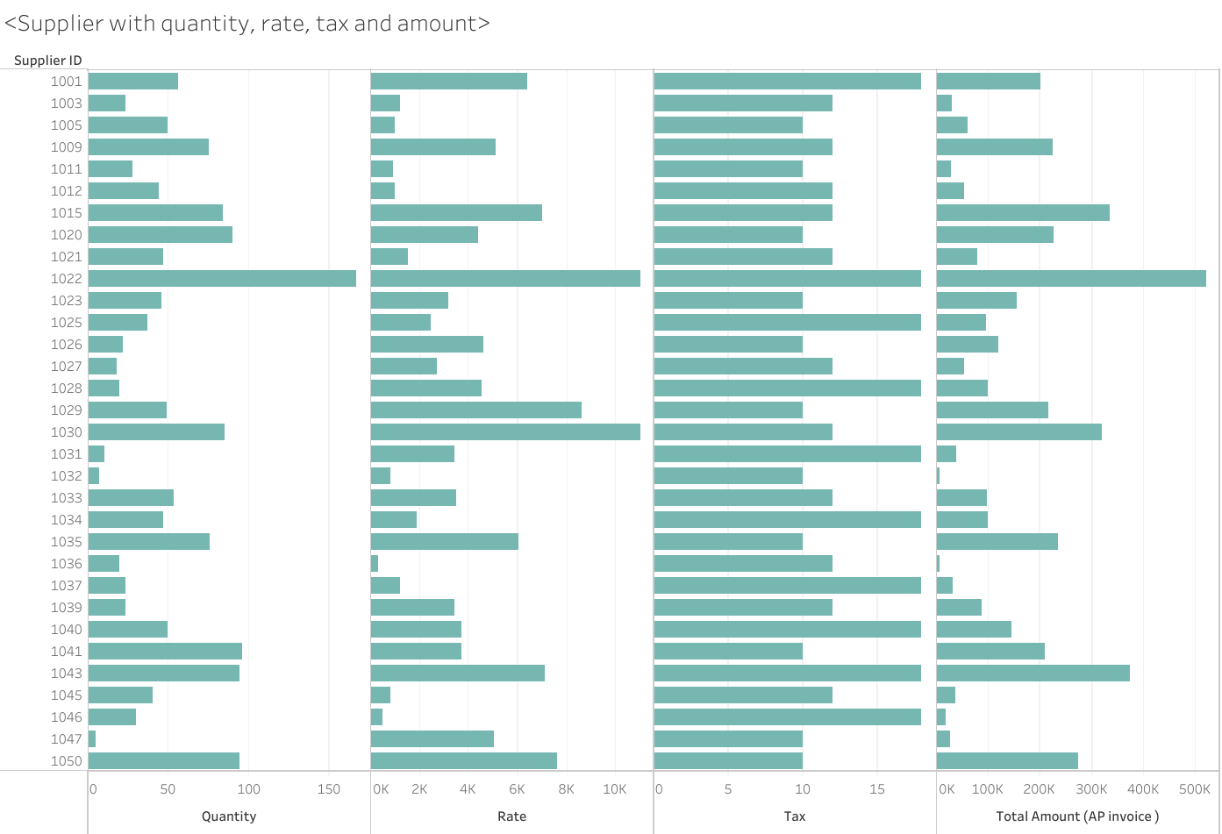

Slide 11
Recommendation
The focus was on a metal company but it’s a good ERP software for all the manufacture company, who are planning to start a new manufacturing plant.
Adding finance module to the software which is currently not mapped but are designed in the eer and uml mode will bring a light to the software. Specially mapping the accounting system like chart of account, balance sheet, GL control and profit and loss statements etc. will enrich this ERP software can be used by any manufacturing company.

